Slide 1
HomeSec
Bereket Assefa 20170844
Bibek KC 20190876
Manoj Pandey 20180869
Timothy MM 20170879

Slide 2
Motivation
Protect homes from theft and crime
Peace of mind
Adding a layer of defense against intruders
Expense of human monitoring of security cameras
Gain experience in
making Cyber and Physical entities work together
utilizing cloud services
using SOA modeling for a business-centric project

Slide 3
SOA Goal
Enable automated monitoring of homes and minimize human labor required
Enable intruder threat resolution through methods such as alerting neighbors or emergency services
Provide automated recognition of trusted humans through face recognition
Enable automated storage of evidence (photo/video) of suspected threats
Enable retrieval of evidence of suspected threats

Slide 4
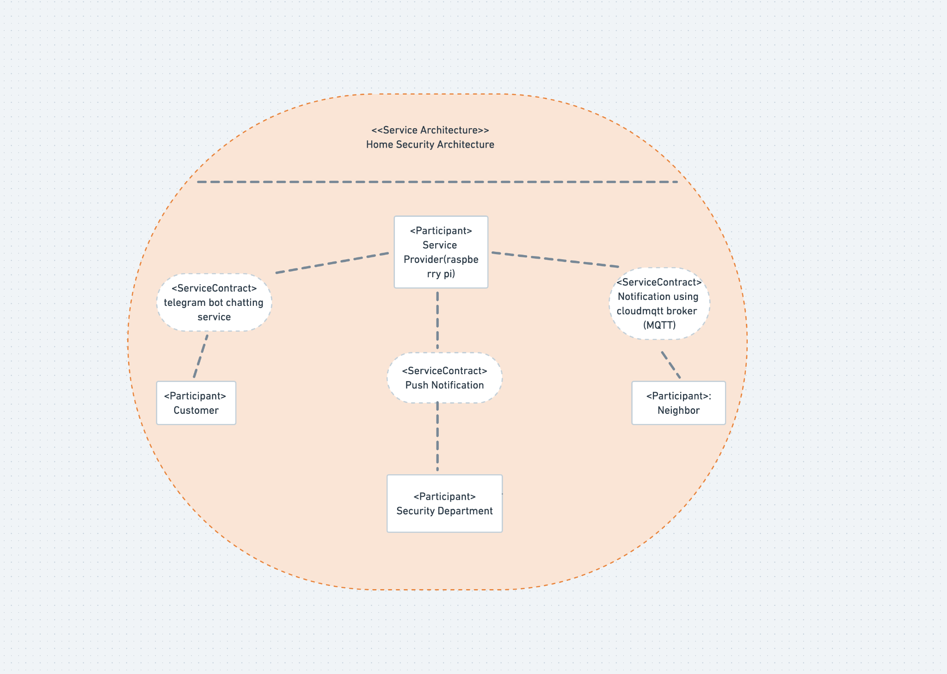
SOA design-Community Model

Slide 5
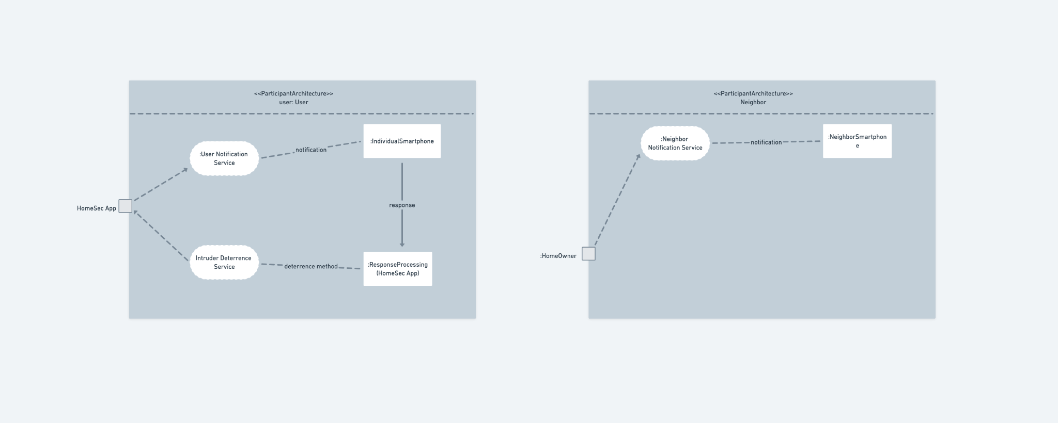
SOA design-Architecture

Slide 6
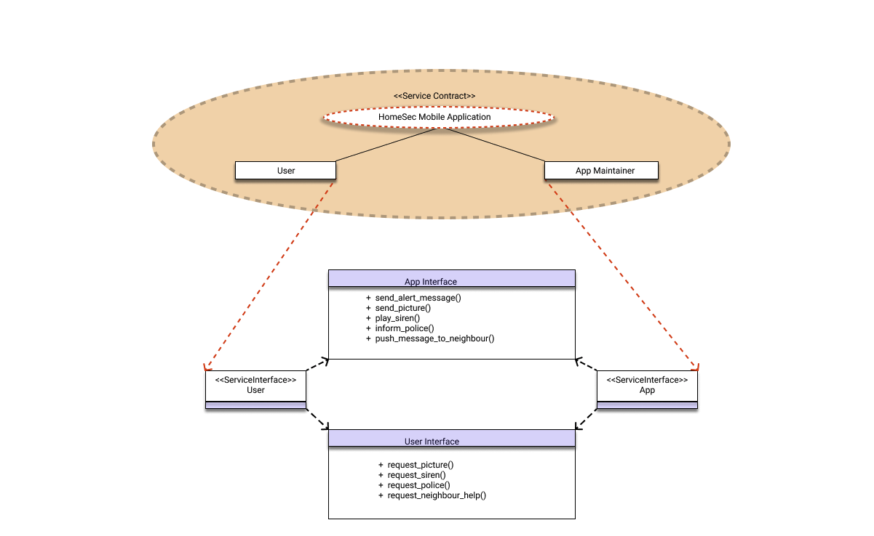
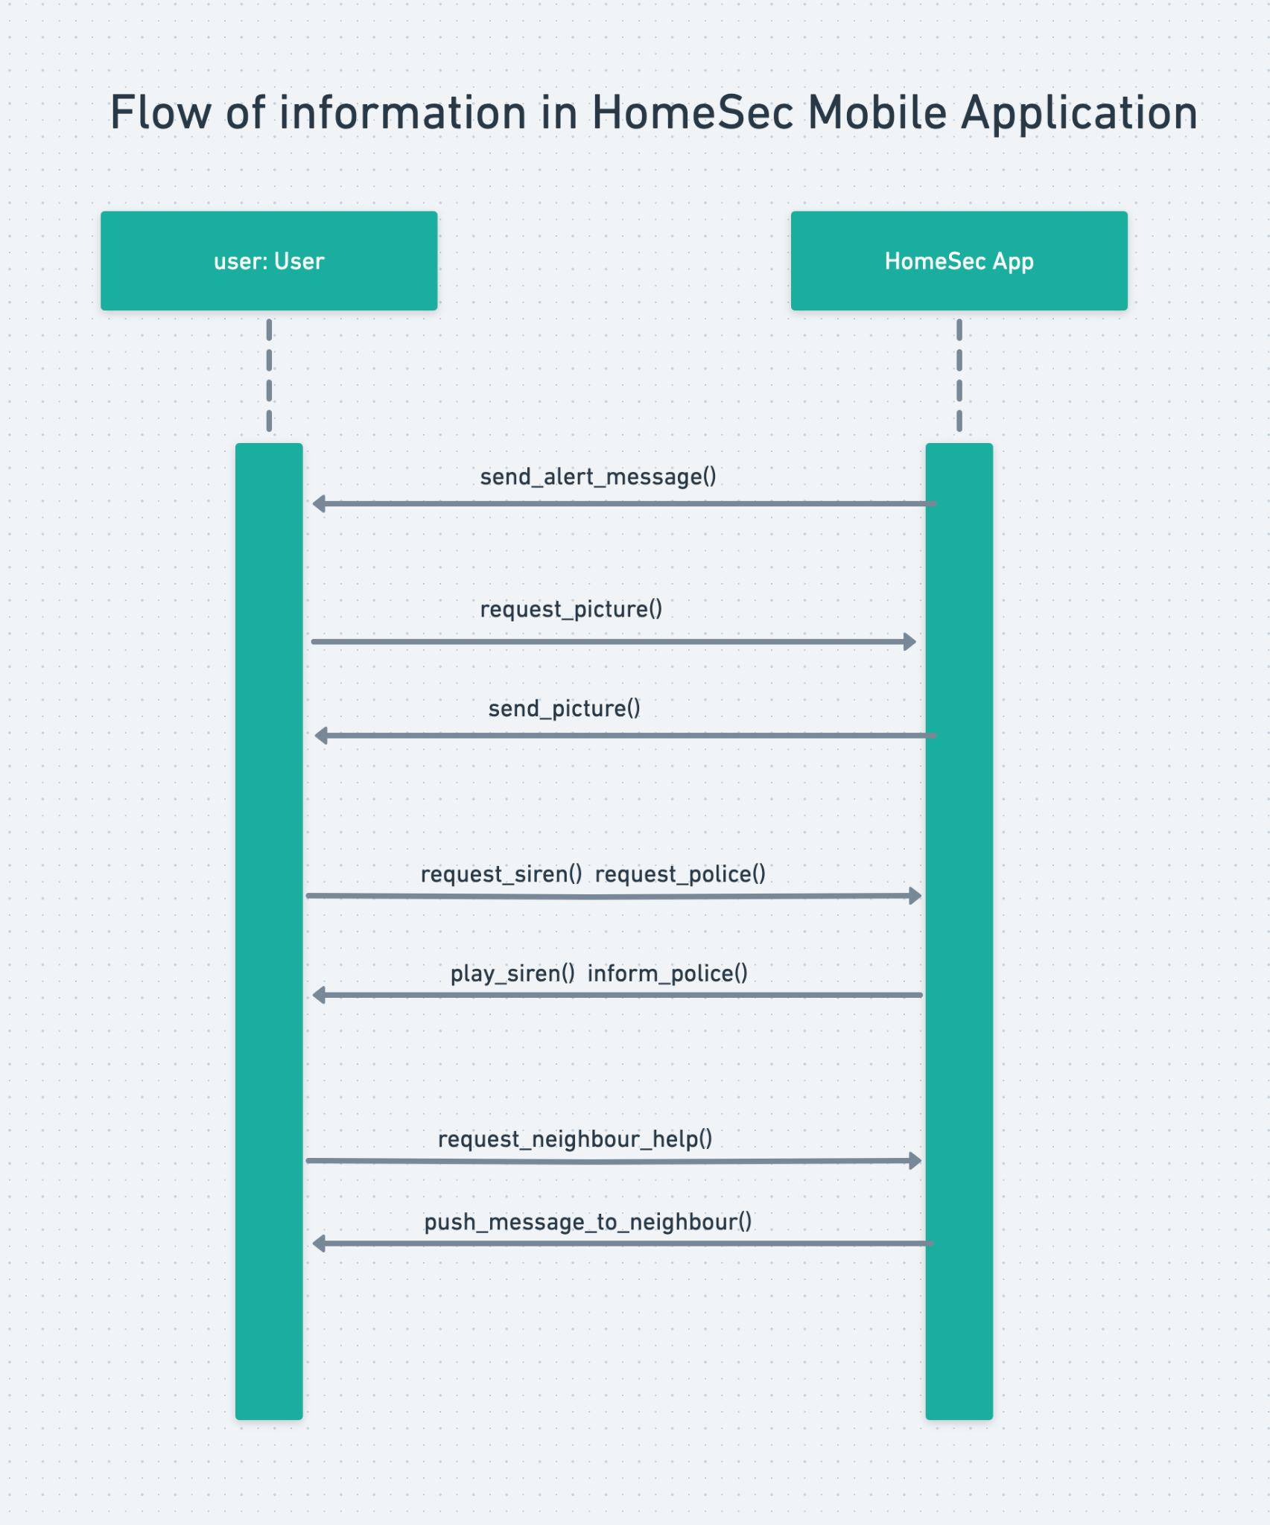
SOA design-Service Contracts

Slide 7
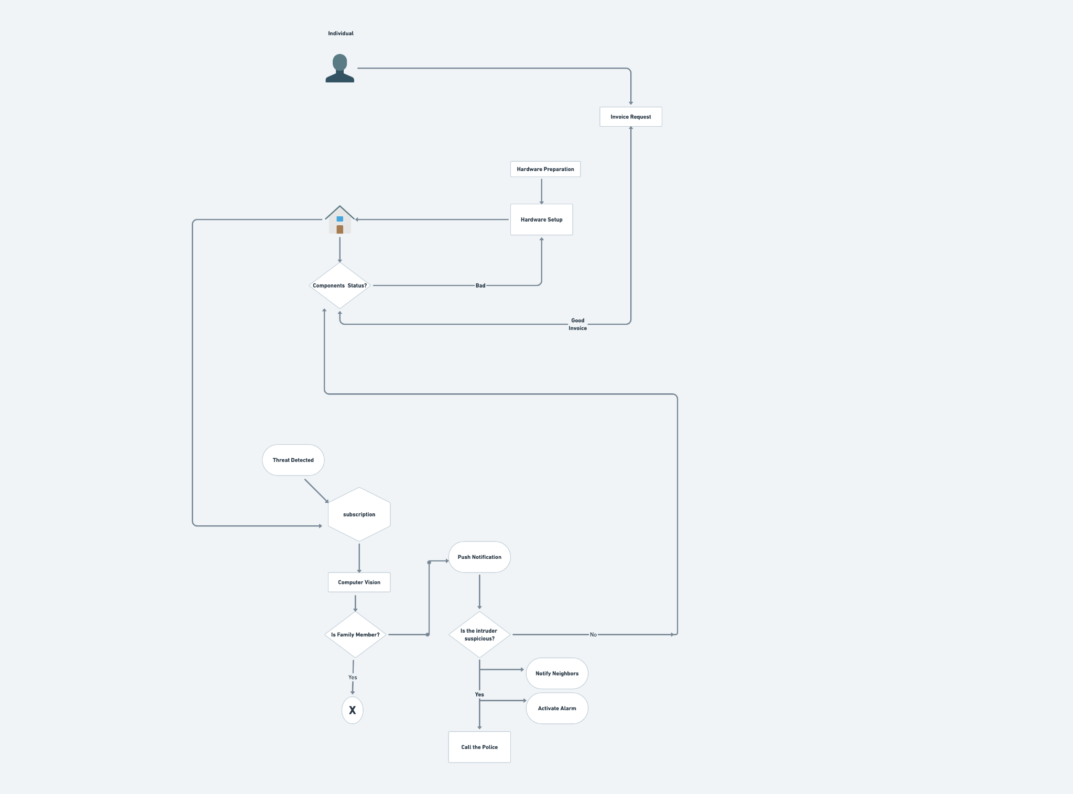
Business Process

Slide 8
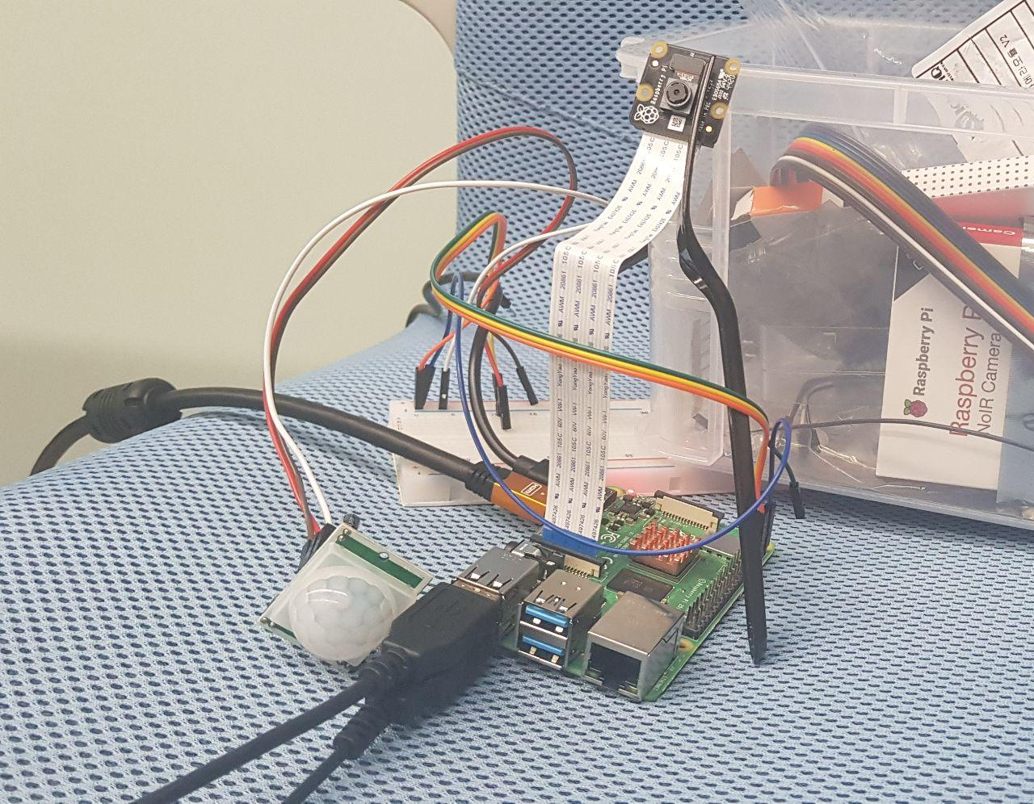
Technologies Used

Slide 9
MQTT
MQTT is a publish and subscribe network protocol to transport messages
It is available as a node in Node-Red
MQTT in node subscribes to a message to a message broker
MQTT out node publishes a message to a broker.
Used cloudmqtt as our message broker
User and neighbor communicate using MQTT protocol.
The user publishes and neighbor subscribes to a message that will alert using voice and message.

Slide 10
Node-Red-I
We employed Node-Red for ease as it has many nodes to be used.
Debugging was a bit challenging.
We used it as a core engine for our service
Used flows and nodes such as exec node, function nodes, raspberry pi nodes,etc ..
Built telegram bot
Used Node-Red Dashboard on the phone using red mobile application(for the neighbor).

Slide 11
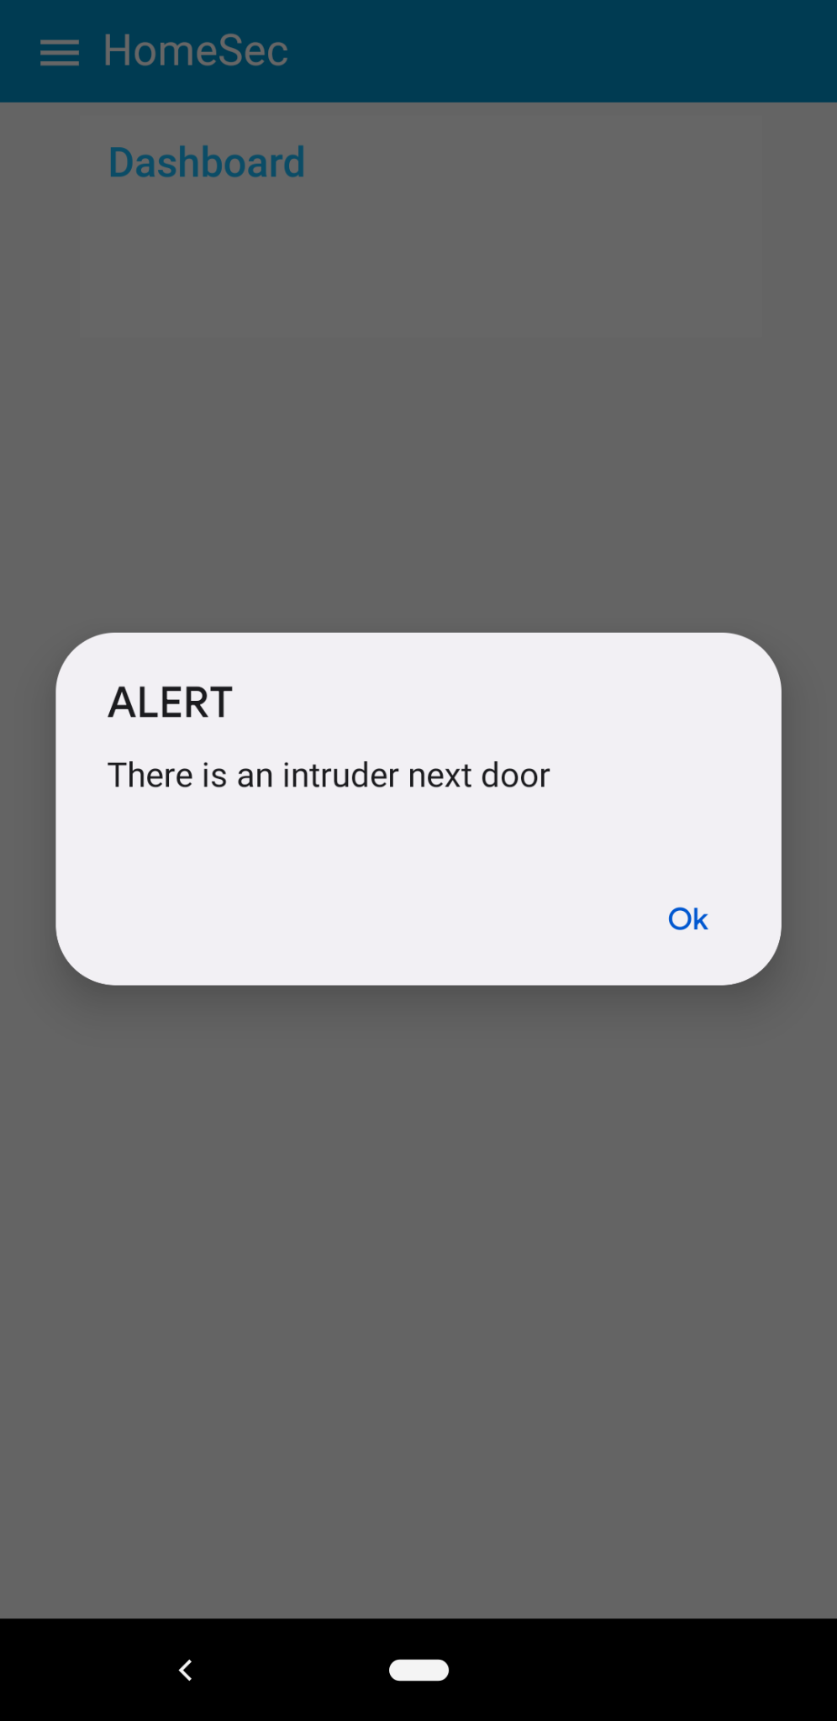
Node-Red-II
Voice Alert sent to neighbor as well as message(to be demonstrated).
Sample alert displayed to the neighbor

Slide 12

Telegram Bot API
Sends alert to the user
Get responses from the user and send message to raspberryPI

Slide 13

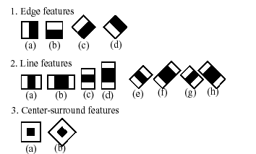
Face Recognition Technology
Haar-Cascade Classifier

Slide 14
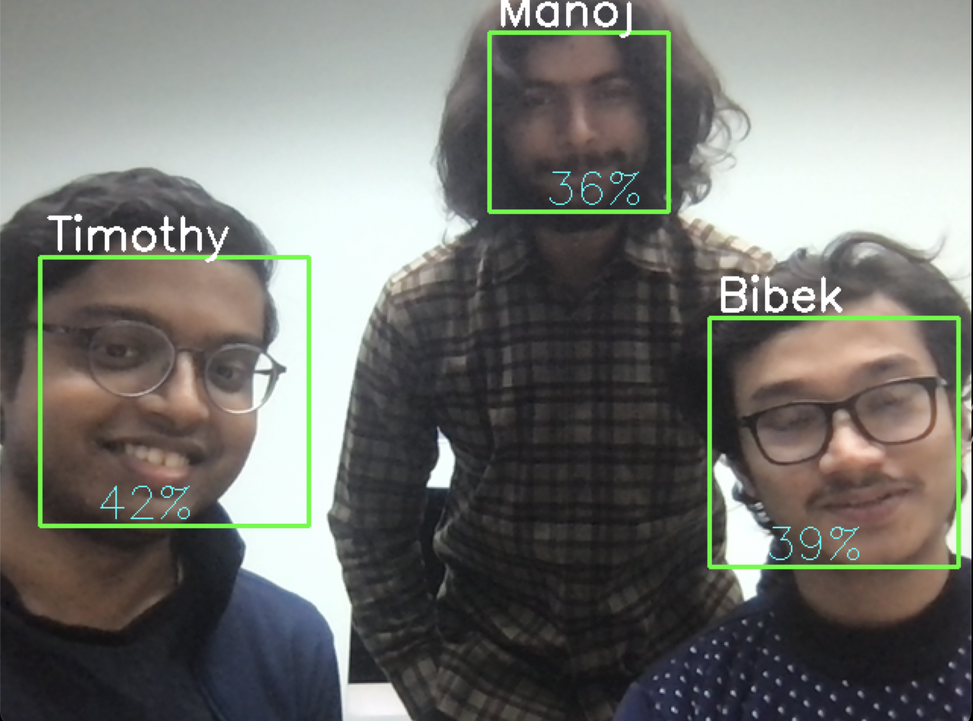
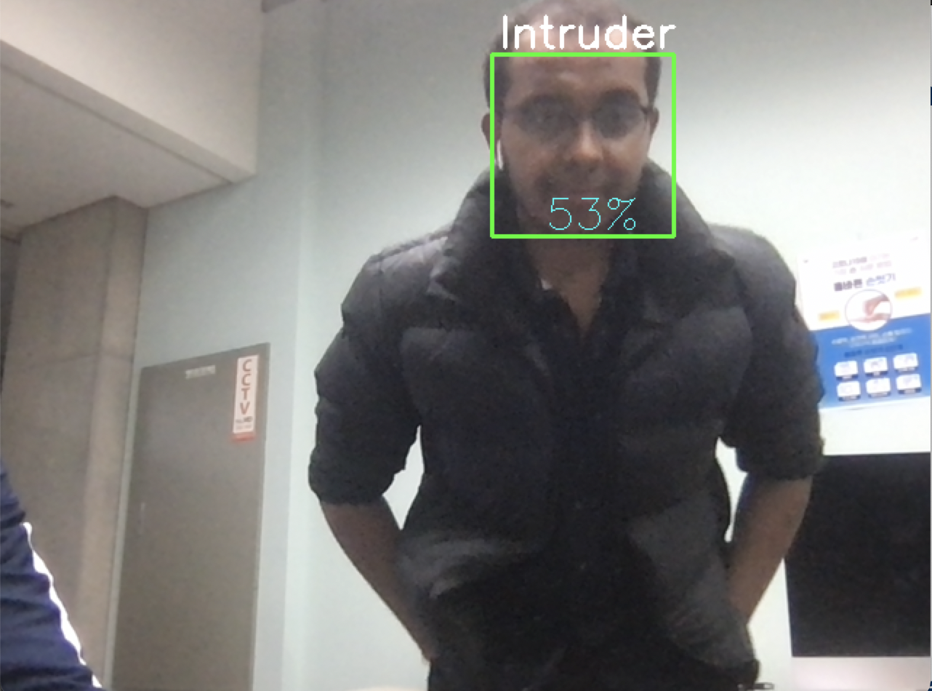
Demo Haar-Cascade Face Recognition

Slide 15
SOMA Activities
2. Specification & Realization:
Data Architecture
Quality of Service
Feedback component
Audit component
Integration
Notification Component

Slide 16
SOA Strategy
Top-Down
Bottom-up
Multiple Service Invocation strategy

Slide 17
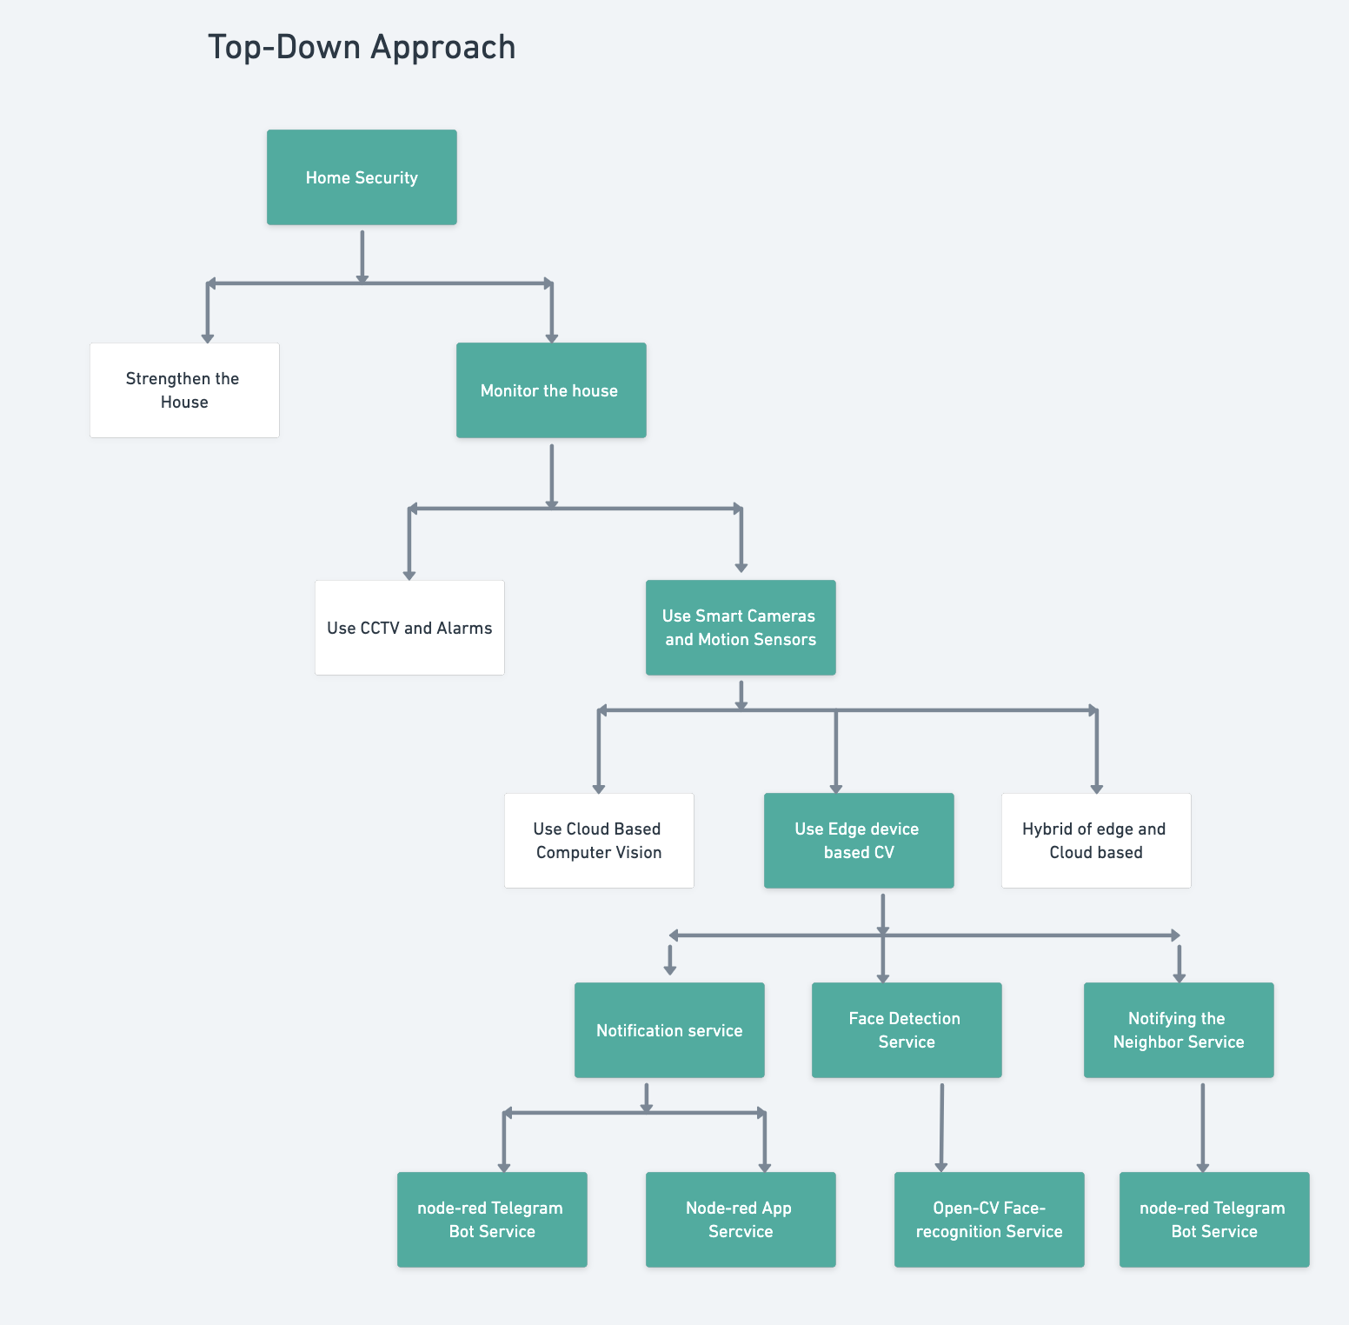

Slide 18
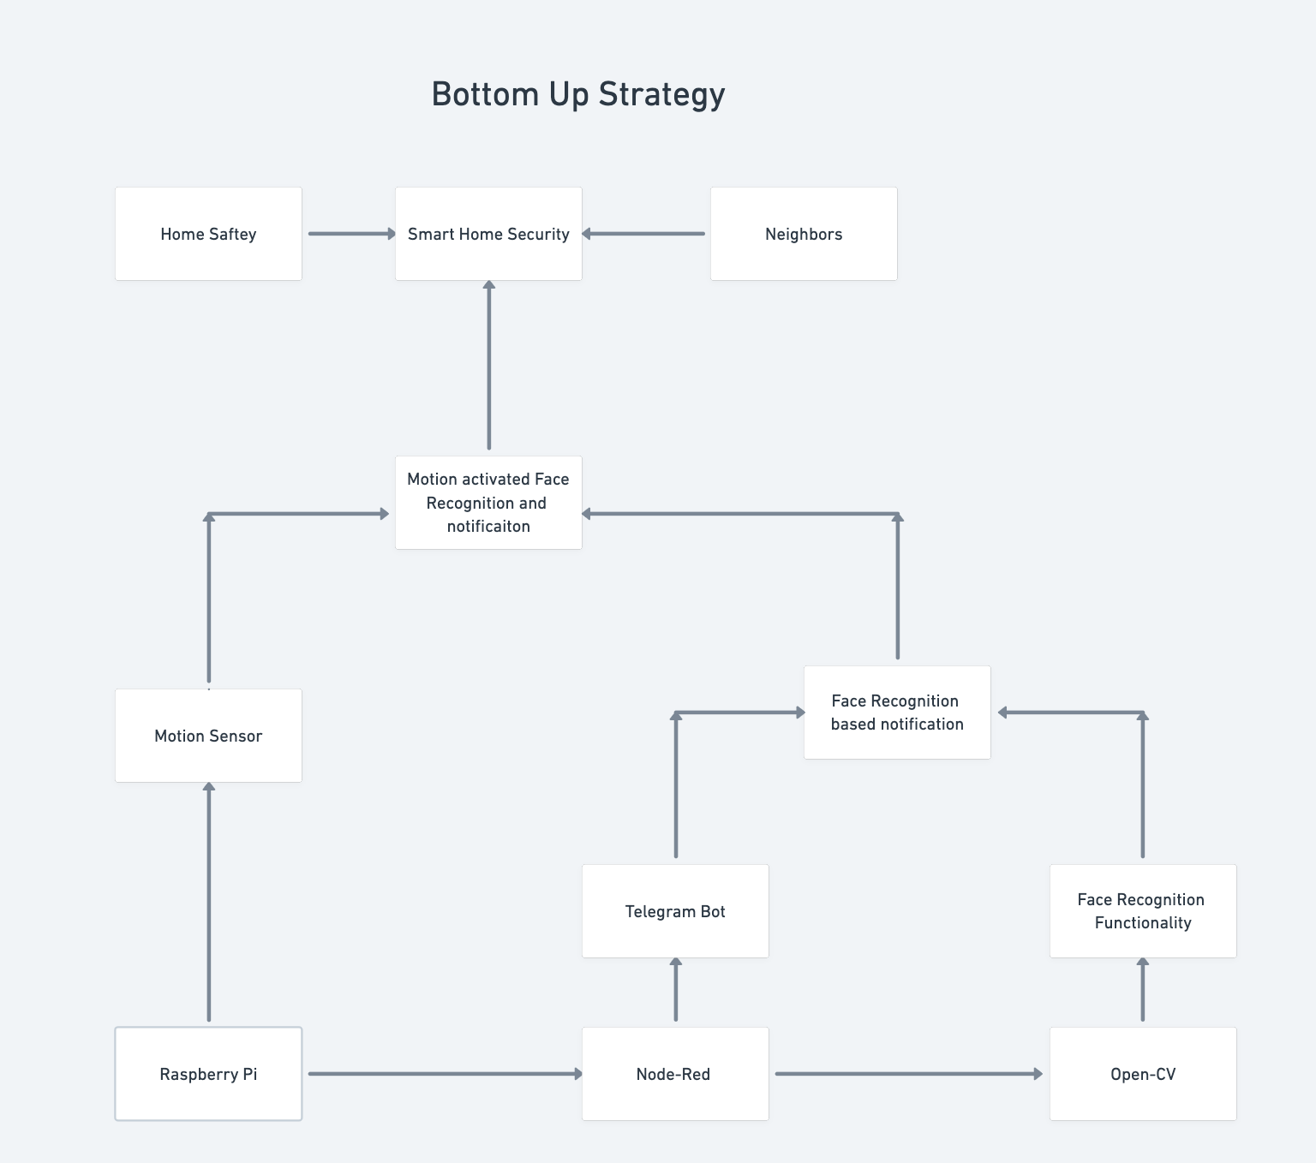

Slide 19
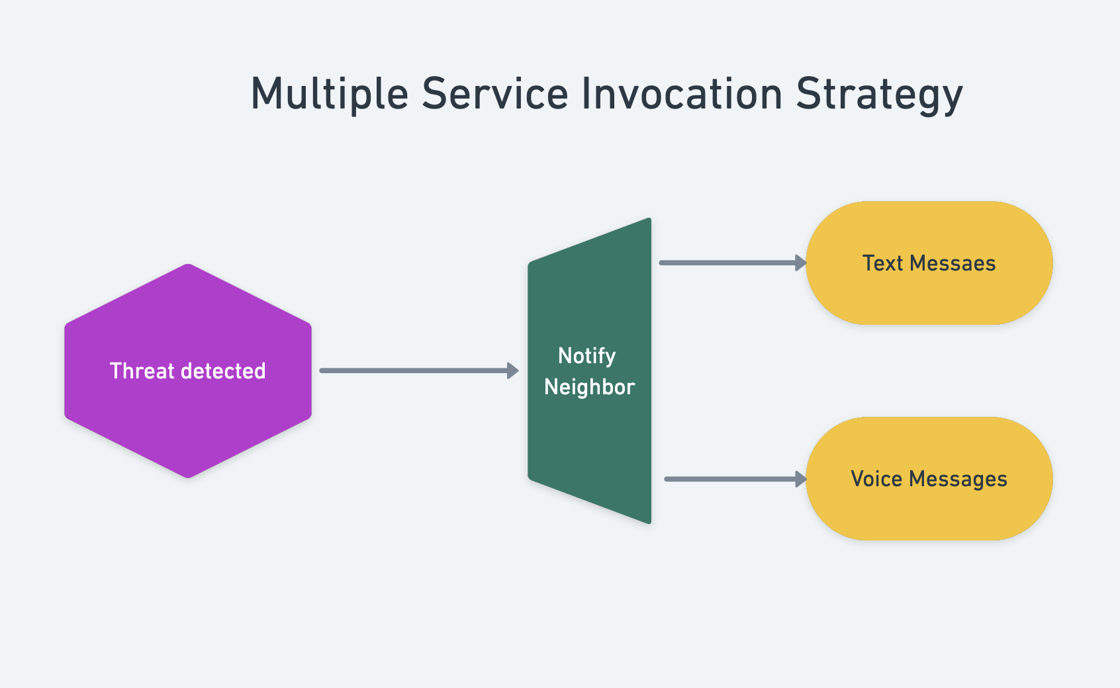

Slide 20
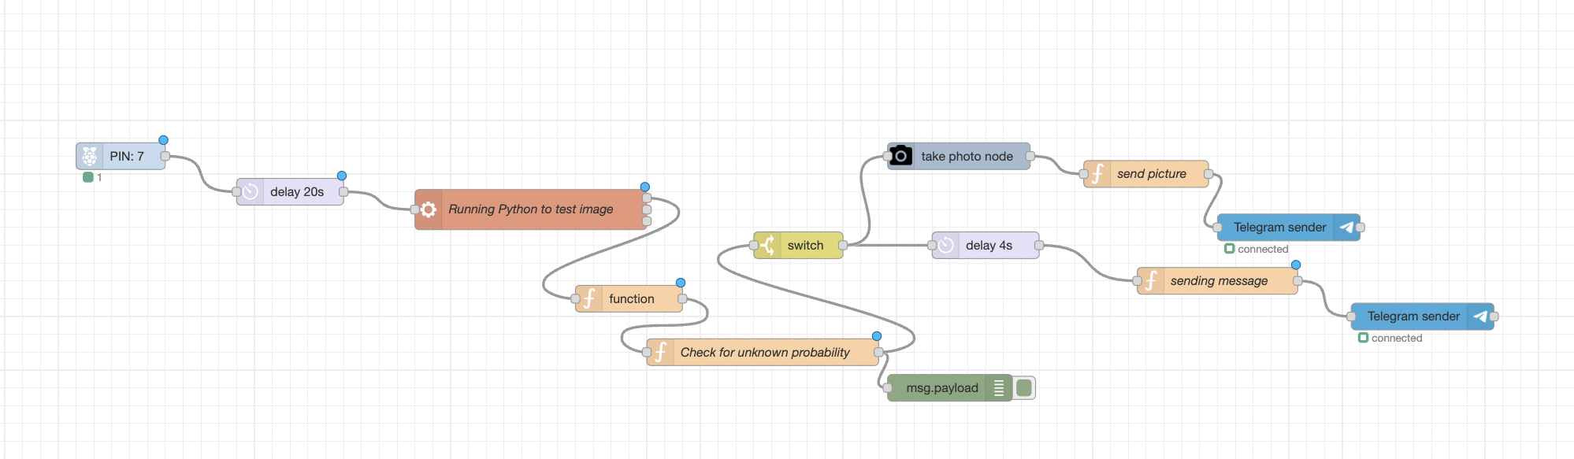
NODE-RED FLOWS:
After sensor detects the movement, our python code is activated and it gives the result, which is processed to find out the probability of unknowns predicted and then accordingly, we send the image to telegram bot.

Slide 21
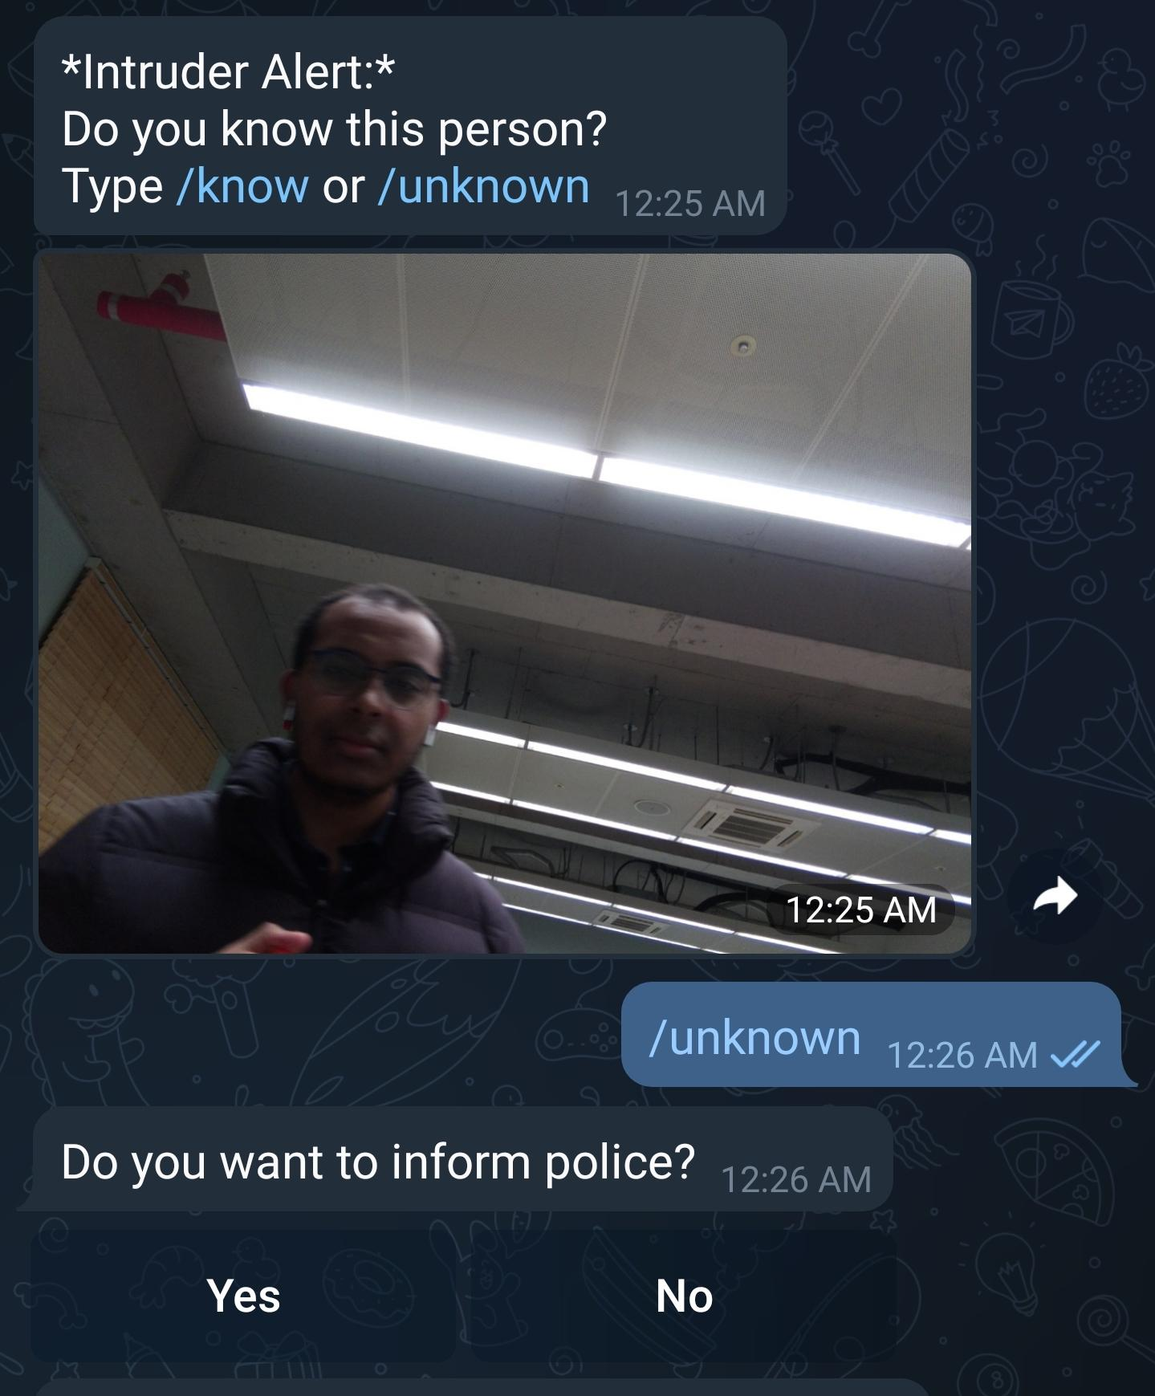

Slide 22
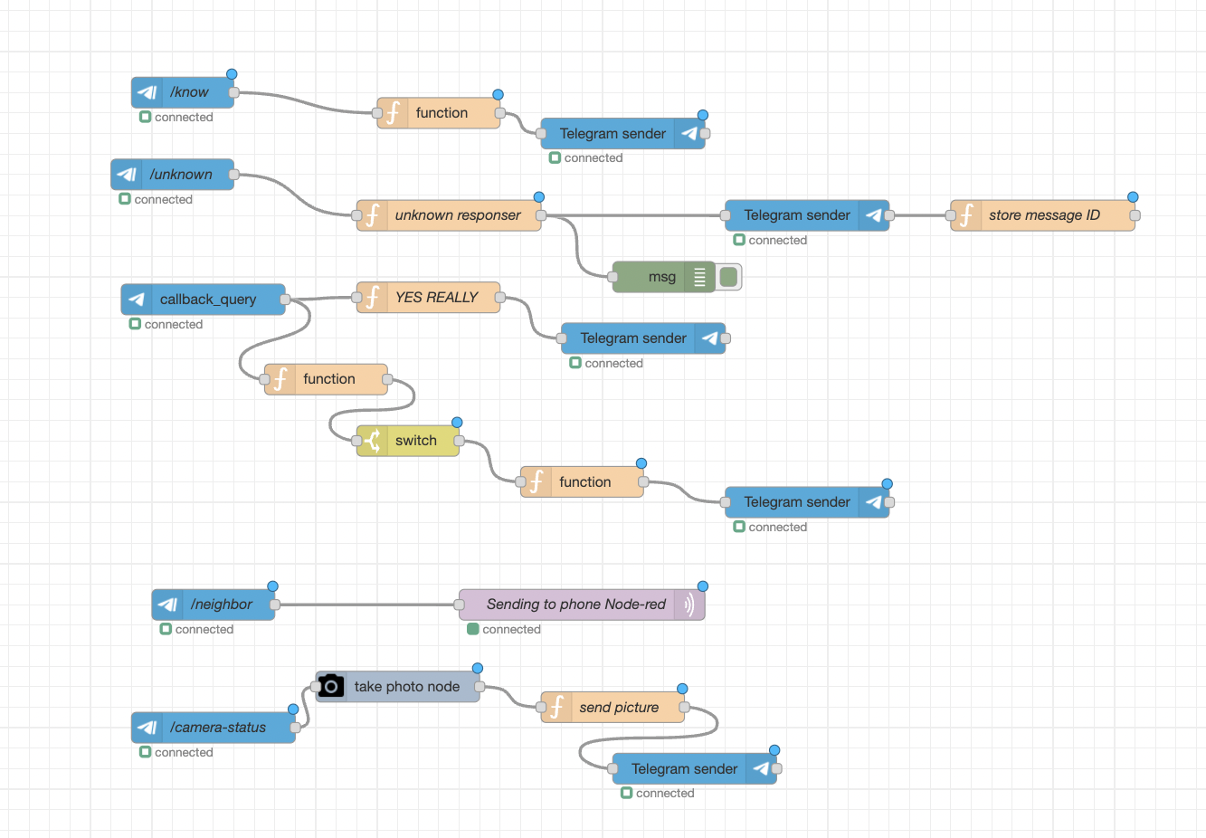
The corresponding actions are taken if user responds that the person is known or unknown

Slide 23
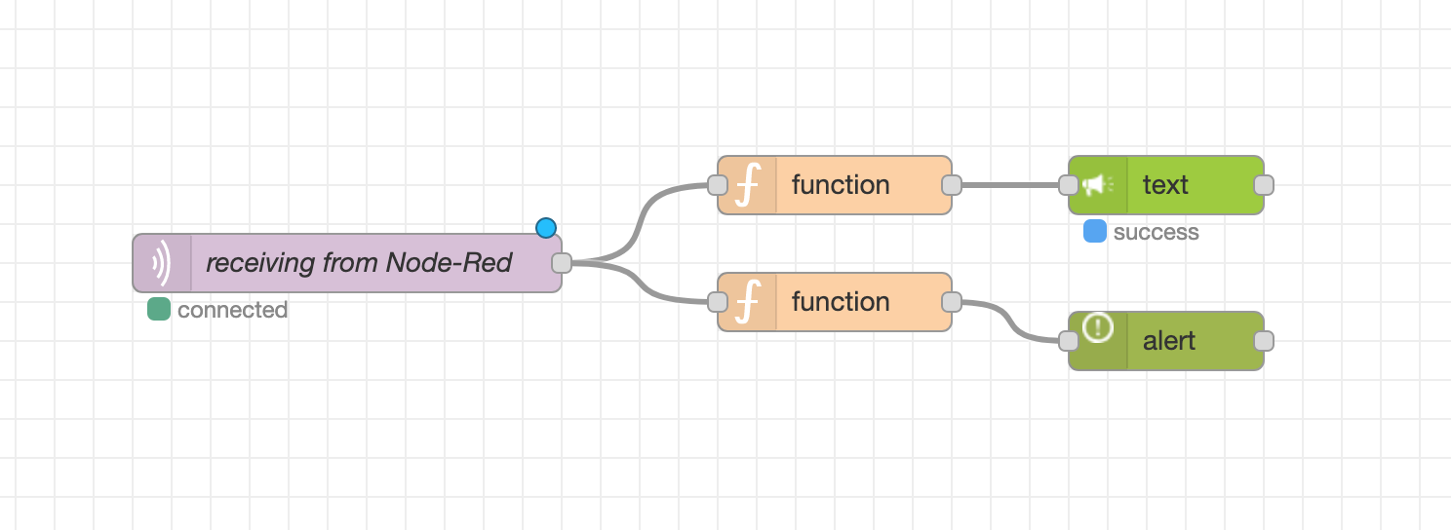
After receiving signal from the Node-Red of raspberry pi, mobile shows alert and gives voice notification.

Slide 24
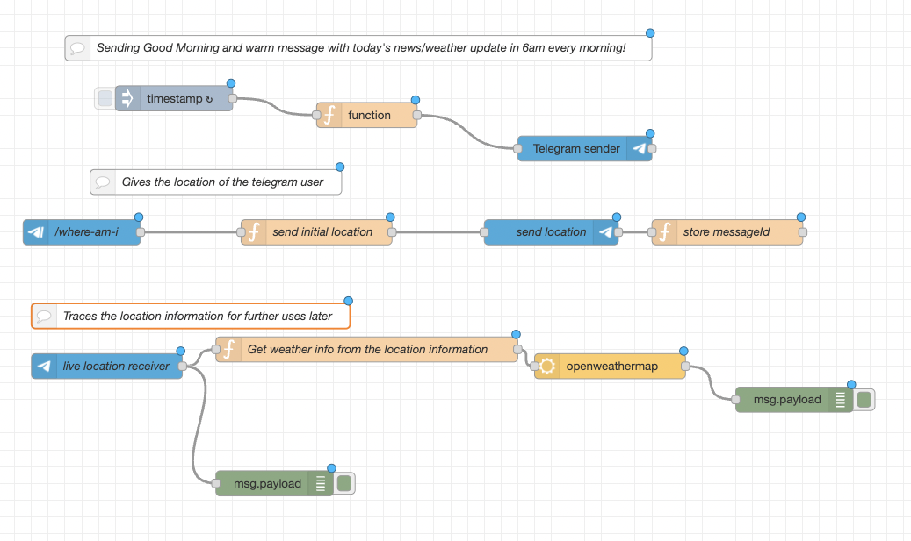

Slide 25
Resources:
GitHub Repository: https://github.com/bibekyess/HomeSec
Demo Video: https://youtu.be/YhccA0mm2YA
Reference: https://github.com/kunalyelne/Face-Recognition-using-Raspberry-Pi

Slide 26
Pros
Utilizes resource constrained devices
Edge-devices based Face-Recognition Services
Energy Efficient
Highly Economic
Optimal Hardware resource utilization
Utilizes mostly open source resources
Fast to implement and make it working
Highly Scalable

Slide 27
Cons
Computer vision performance could be improved
UI could be improved
Physical limitation (Not a complete WEB service)
Contains limited Functionality and services
Limited hardware resources and sensors

Slide 28
Future work
State of the art CV
Add more Services mashups
Add more participants in the Service Architecture
Integrate hybrid model: edge and cloud based services.

Slide 29
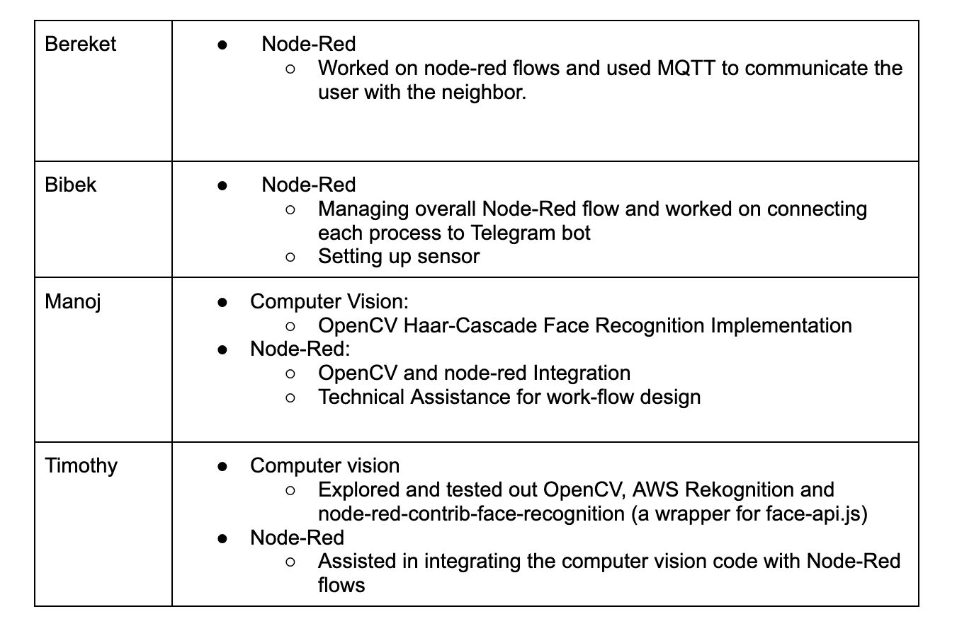
Work division and Contribution:

Slide 30
Lessons Learned
Node-Red is simple but that can become a limiting factor. It has less flexibility than coding in a native environment
Can be tricky to use poorly documented APIs (e.g. unofficial Node-Red wrapper of AWS SDK for Javascript made by a random person)
Importance of using a shared, synchronized space that keeps everyone aware of the status of each part of the project. (e.g. Trello Board)

Slide 31
Thank you

